Slide 1


CAPSTONE PROJECT PRESENTATION
CSA1107- COMPILER DESIGN
AI-Driven Intelligent Compiler Framework for Automated Error Diagnosis and Context-Aware Validation of Clinical Decision Support Rules
Presented by:
Bhagya Shree S – 192521338
M.Varshini – 192421293
T.Vaishnavi – 192421370
K.Gayathri – 192421319
K.Madhulika – 192524190
Guided by:
Dr. Anitha C

Slide 2

INTRODUCTION
Healthcare organizations use Clinical Decision Support (CDS) rules to assist doctors in diagnosis and treatment.
Manually created CDS rules may contain lexical, syntax, semantic, and logical errors.
Existing tools detect technical errors but lack clinical validation and intelligent explanations.
The proposed AI-Driven Intelligent Compiler Framework validates CDS rules using compiler techniques and AI before storing them in the database.
Validated rules are used to provide doctors with safe recommendations and real-time warnings during patient care.

Slide 3
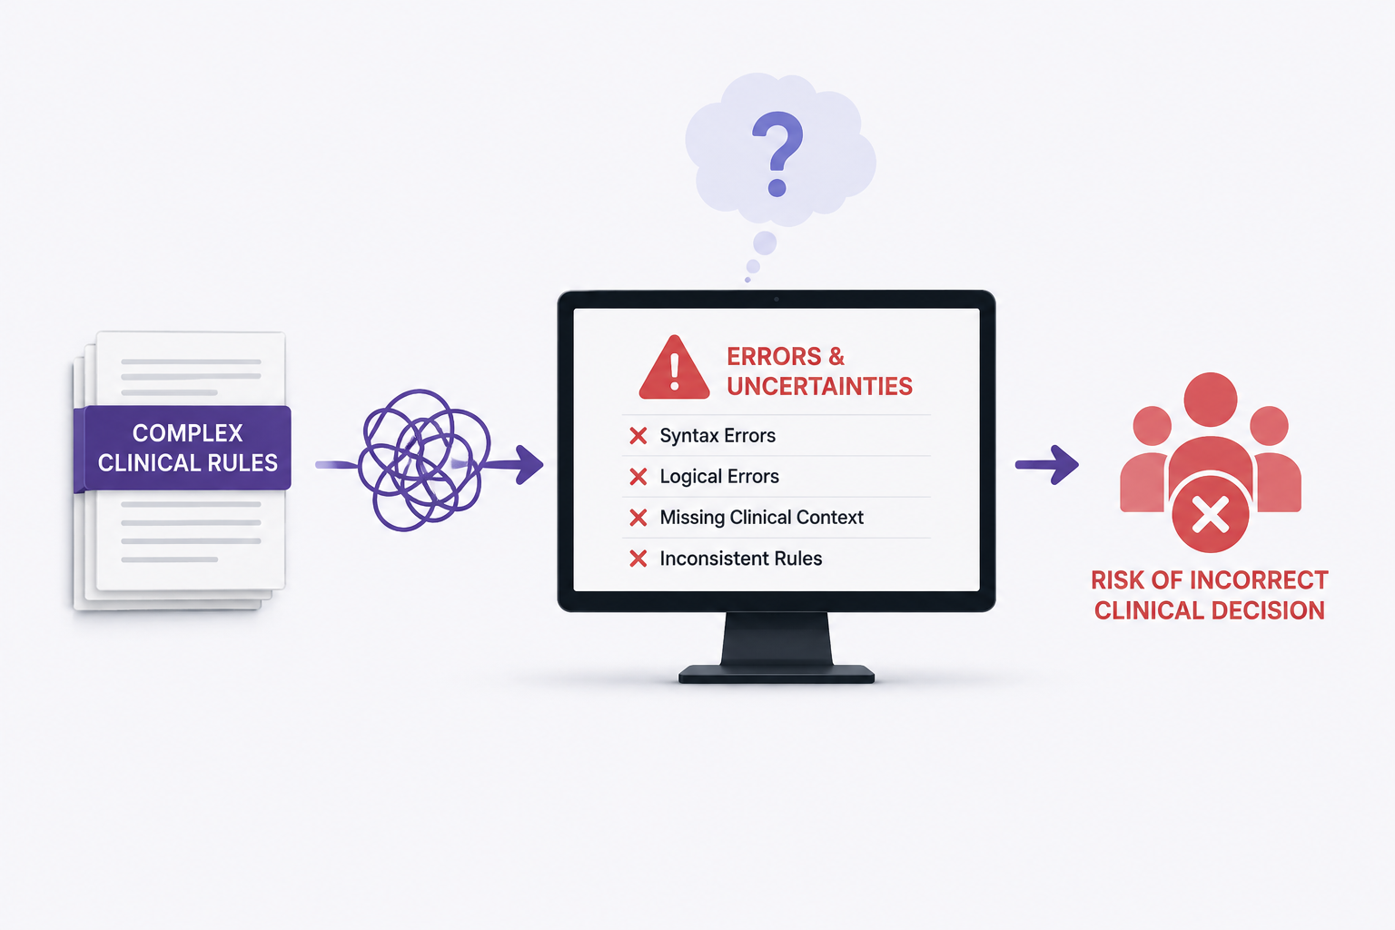
PROBLEM STATEMENT
Difficult to detect lexical, syntax, semantic, and logical errors in CDS rules.
Limited clinical context and intelligent error explanations.
Manual rule validation is time-consuming and error-prone.
Invalid CDS rules may be stored and used in clinical practice.
Incorrect rules can lead to unsafe recommendations and impact patient care.

Slide 4
OBJECTIVE
.
.
Develop an AI-driven compiler framework for Clinical Decision Support (CDS) rules.
Detect lexical, syntax, semantic, and logical errors in CDS rules.
Validate CDS rules using AI-assisted analysis before storing them in the Rule Repository.
Generate intelligent error explanations and correction suggestions.
Apply validated rules to patient data to provide safe recommendations and real-time warnings.
Design an interactive dashboard for rule validation and clinical decision support.

Slide 5


EXISTING VS PROPOSED SYSTEM
Basic syntax validation of CDS rules only.
Generates technical error messages.
No understanding of clinical context.
Manual identification and correction of rule errors.
No patient-specific decision support.
AI-driven lexical, syntax, semantic, logical validation.
Human-readable AI error explanations.
AI-assisted validation using validated CDS rules.
Intelligent correction optimization suggestions.
Patient-specific recommendations and alert

Slide 6
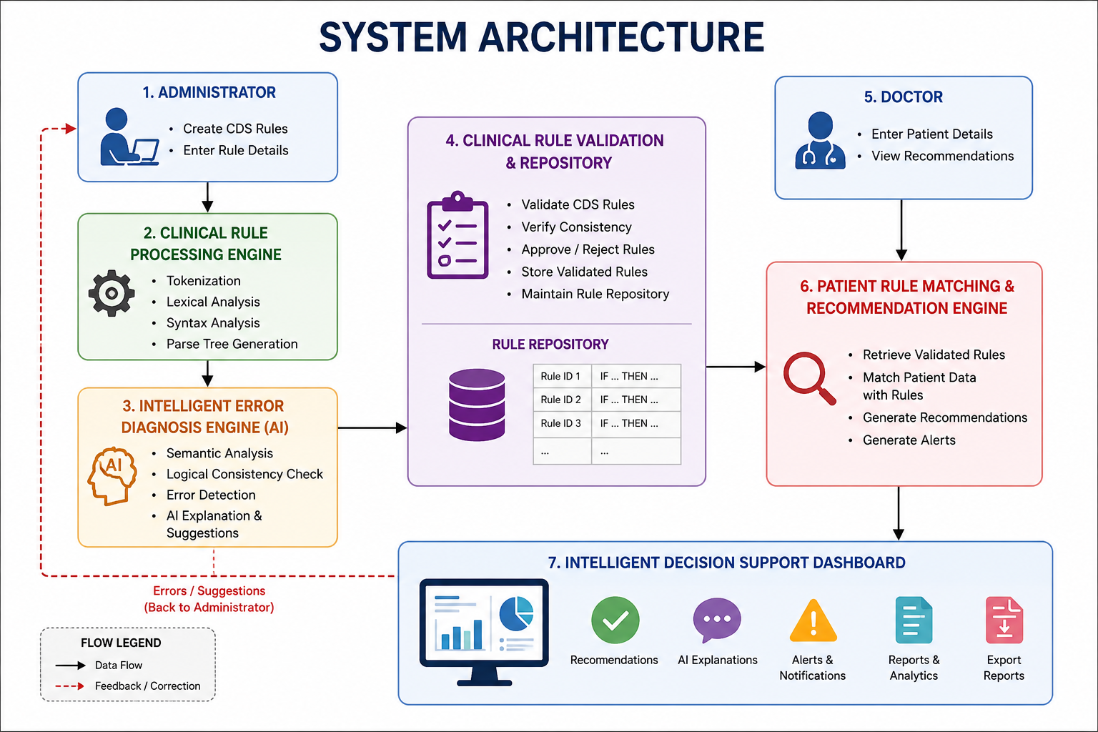
SYSTEM ARCHITECTURE

Slide 7
Module 1: Clinical Rule Processing Engine
Purpose
To process Clinical Decision Support (CDS) rules and prepare them for intelligent validation through lexical and syntax analysis.
Functions
Accepts Clinical Decision Support (CDS) rules as input.
Performs tokenization of rule elements.
Conducts lexical analysis to identify valid tokens.
Performs syntax analysis to verify rule structure.
Generates a parse tree for subsequent validation.

Slide 8
Module 2: Intelligent Error Diagnosis Engine
Purpose
To analyze Clinical Decision Support (CDS) rules for semantic and logical errors and provide AI-driven error diagnosis.
Functions
Performs semantic analysis of CDS rules.
Detects logical conflicts and inconsistencies.
Identifies missing or invalid rule conditions.
Generates AI-powered error explanations.
Suggests intelligent corrections.

Slide 9
Module 3:Clinical Rule Validation & Repository
Purpose
To validate Clinical Decision Support (CDS) rules, approve valid rules, and securely store them in the rule repository for future clinical decision support.
Functions
Validate CDS rules after lexical, syntax, semantic, and logical analysis.
Verify rule consistency and completeness.
Reject invalid or conflicting rules.
Store validated rules in the Rule Repository.
Maintain a centralized repository of approved CDS rules.

Slide 10
Module 4:Patient Rule Matching & Recommendation Engine
Purpose
To match patient information with validated Clinical Decision Support (CDS) rules and generate appropriate recommendations for clinical decision support.
Functions
Accept patient information from the doctor.
Retrieve validated CDS rules from the Rule Repository.
Match patient data with stored rules.
Generate patient-specific recommendations.
Display alerts when matching rules are found.

Slide 11
Module 5:Intelligent Decision Support Dashboard
Purpose
To present validated CDS rules, patient-specific recommendations, AI-generated explanations, and reports through an interactive dashboard.
Functions
Display patient-specific recommendations.
Show AI-generated explanations for recommendations.
Display alerts and notifications for critical conditions.
Generate rule validation and recommendation reports.
Provide an interactive dashboard for administrators and doctors.

Slide 12
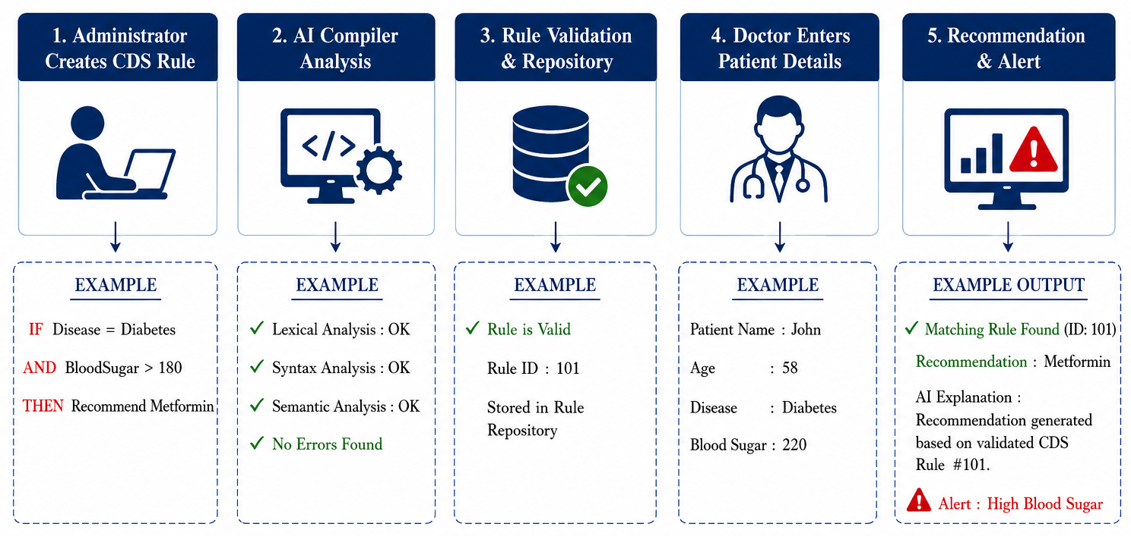
WORKFLOW

Slide 13
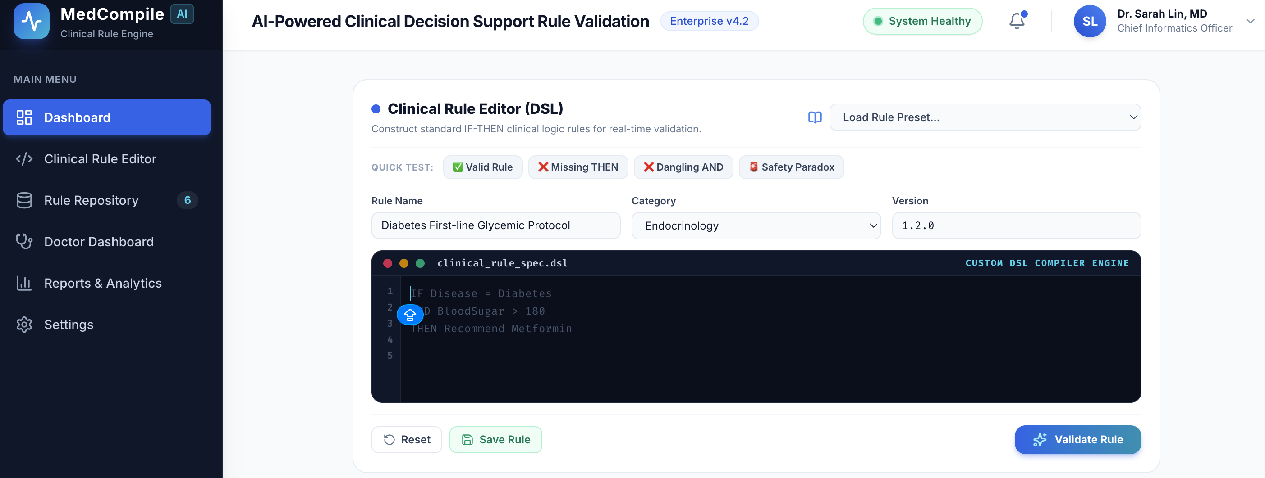
IMPLEMENTATION

Slide 14
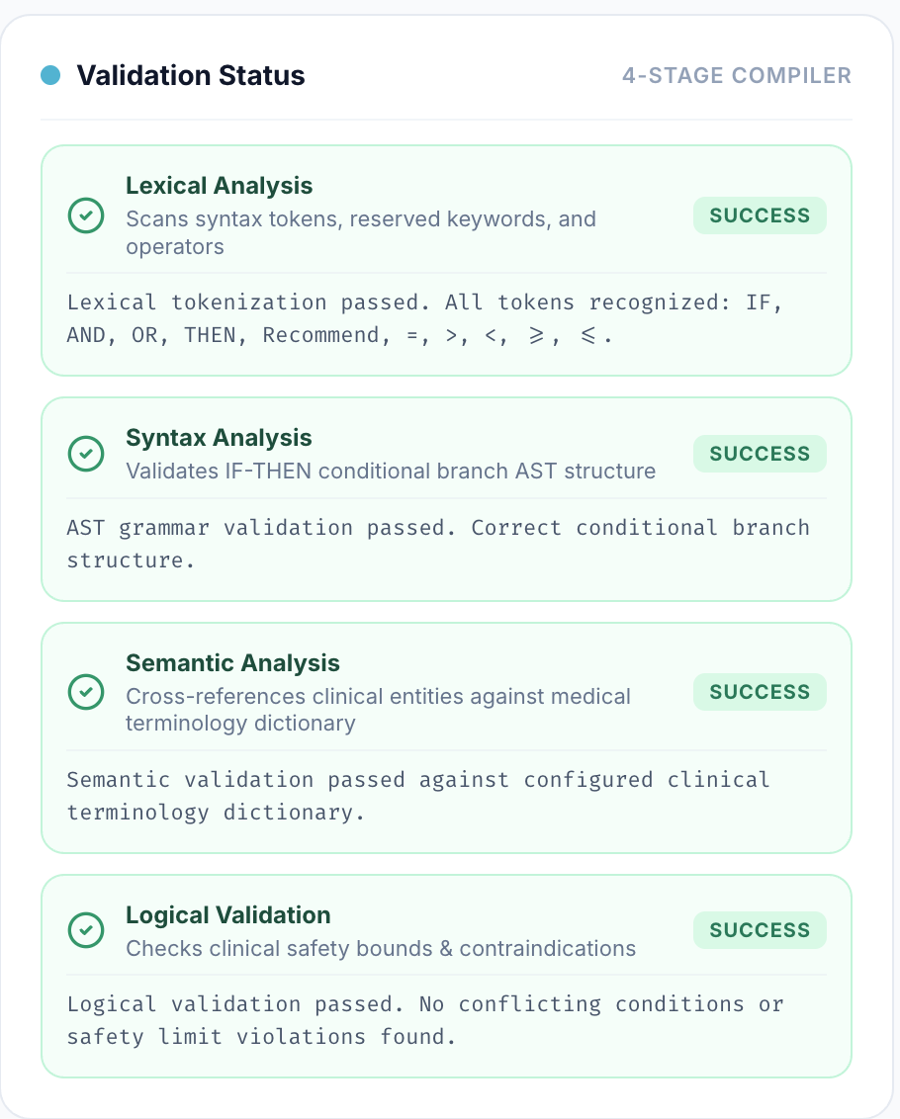
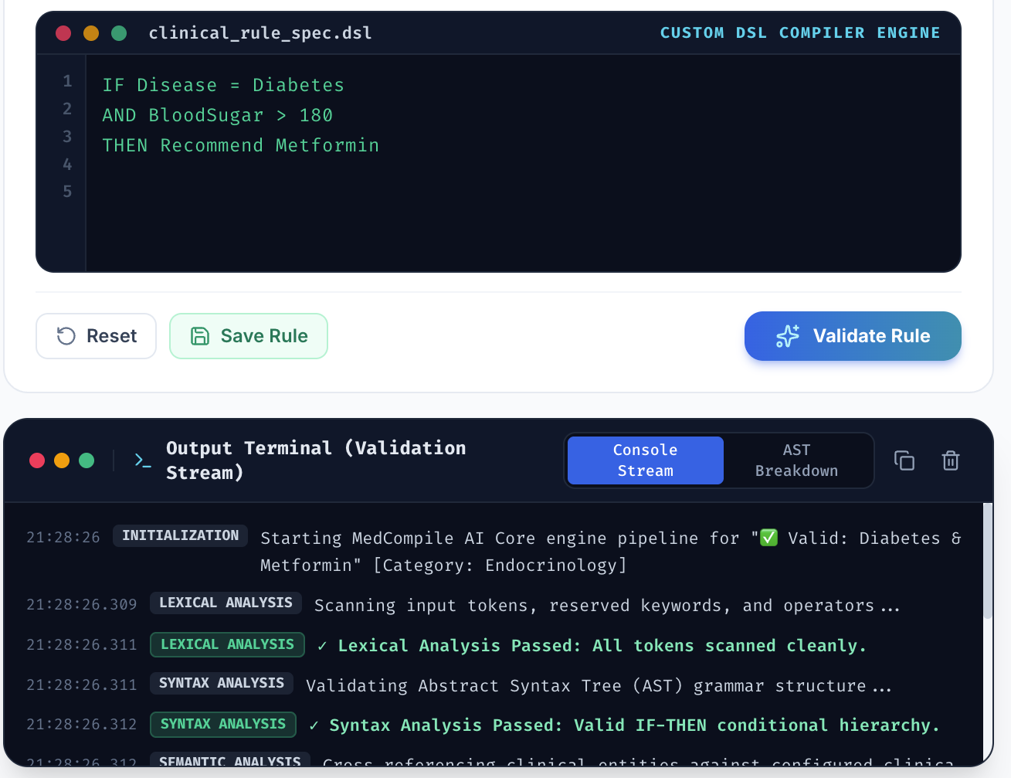
IMPLEMENTATION

Slide 15
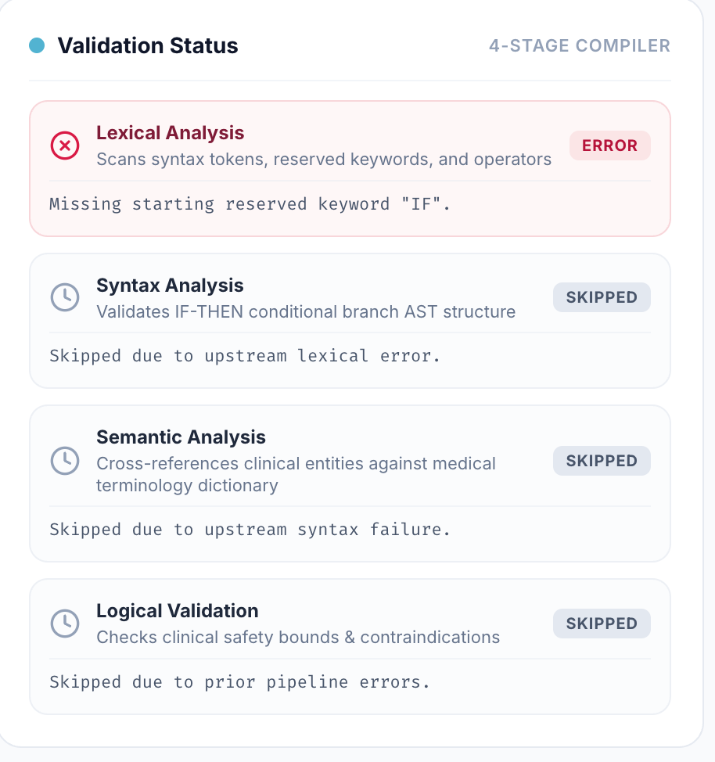
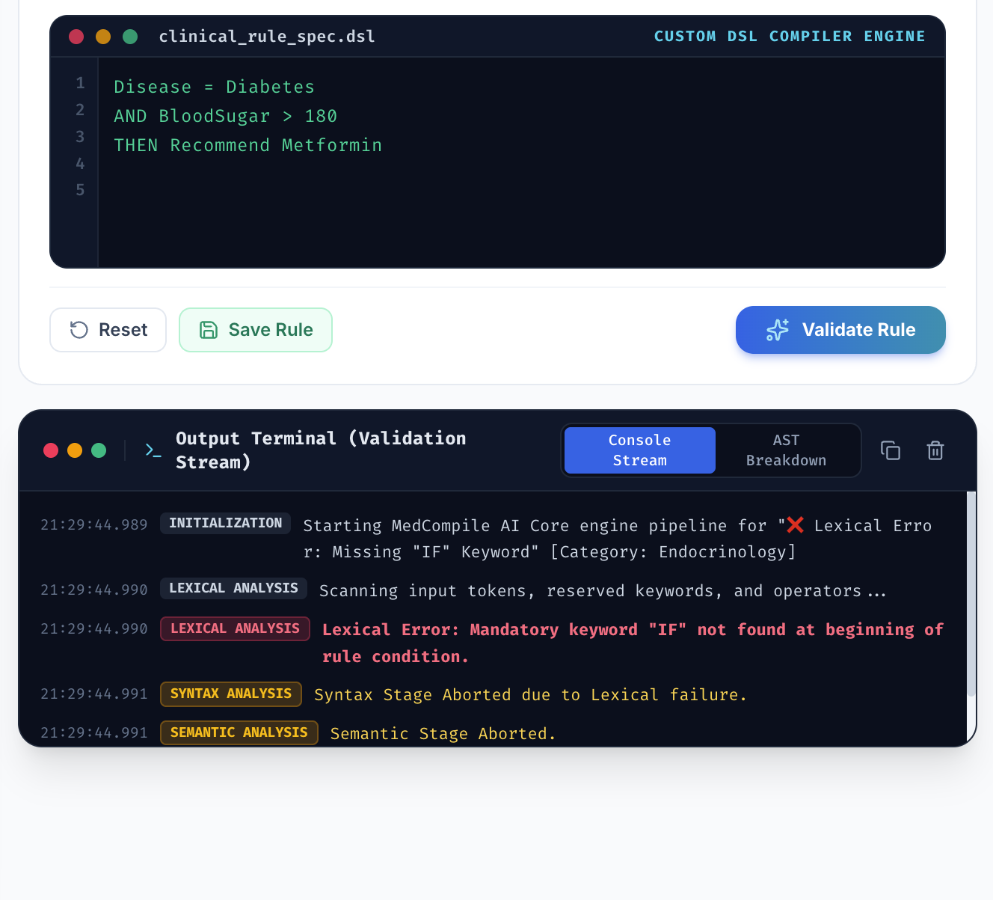
IMPLEMENTATION

Slide 16
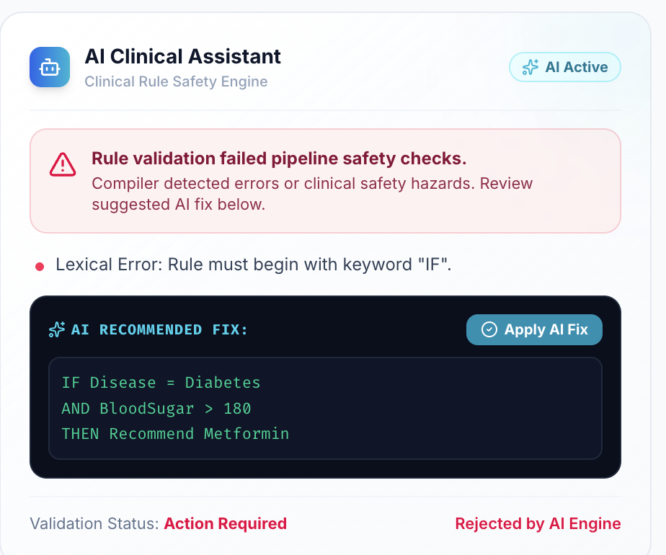
IMPLEMENTATION

Slide 17
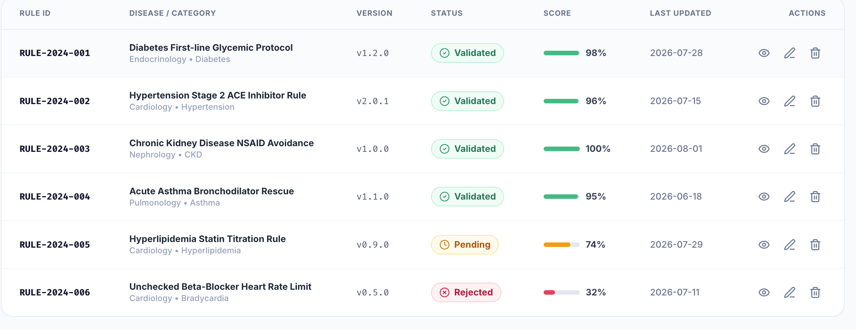
IMPLEMENTATION

Slide 18
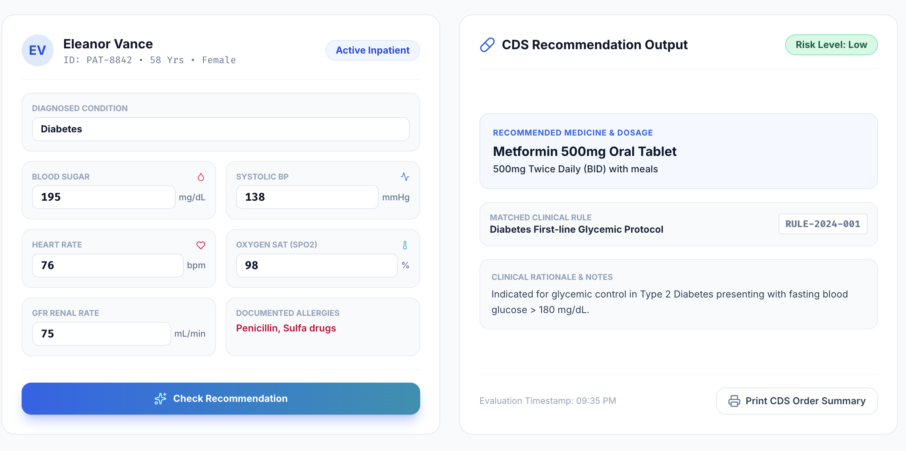
IMPLEMENTATION

Slide 19
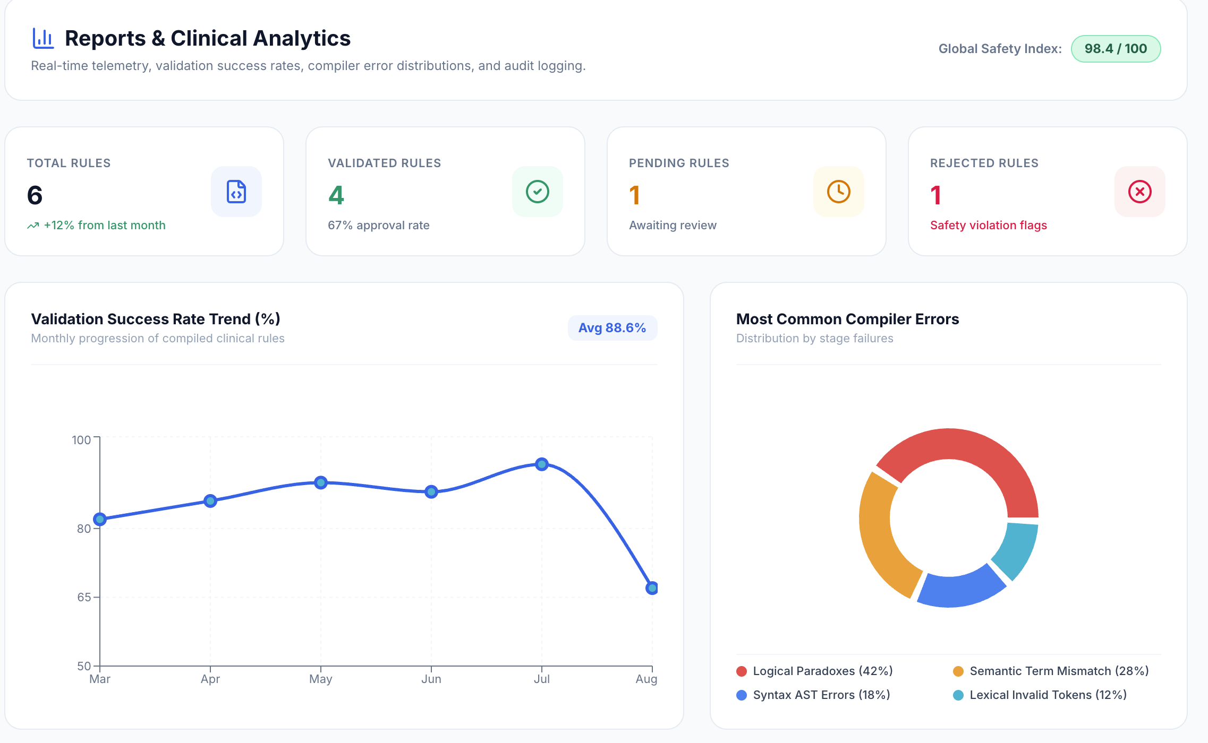
IMPLEMENTATION

Slide 20
RESULT
Successfully performs Lexical, Syntax, Semantic, and Logical Analysis.
Detects and classifies errors at the appropriate compiler stage.
Stops subsequent stages when an earlier stage fails.
Provides error location, explanation, and correction suggestions.
Supports AI-assisted, context-aware error correction.
Provides an interactive interface for rule validation and analysis.

Slide 21
FUTURE SCOPE
Integrate with Electronic Health Record (EHR) systems for real-time rule validation.
Support international clinical standards such as HL7 FHIR and SNOMED CT.
Incorporate machine learning to continuously improve rule validation accuracy.
Enable multilingual support for healthcare organizations worldwide.
Extend the framework to support multiple Clinical Decision Support rule languages.
Develop cloud-based deployment for scalable and secure healthcare applications.

Slide 22
CONCLUSION
Proposed an AI-driven intelligent compiler framework for validating Clinical Decision Support (CDS) rules.
Combines traditional compiler analysis with AI-assisted error diagnosis and validation.
Simplifies rule debugging through intelligent error explanations and correction suggestions.
Improves the quality, consistency, and reliability of CDS rules before deployment.
Provides a smarter, faster, and more user-friendly approach for supporting clinical decision-making.

Slide 23
THANK YOU

